Slide 1

Information abstraction from IoT streaming Greenhouse data
Niketh S A
(1BM16SCS11)
Under the guidance of
Dr. KAYARVIZHY N
Associate professor
Dept. of CSE
BMSCE
BMS College of Engineering
Bull Temple Road, Basavanagudi, Bangalore 560019

Slide 2
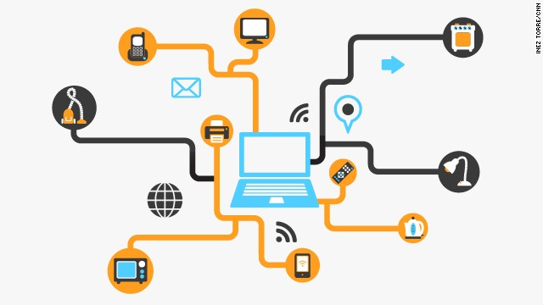
Abstract
Internet of Things (IoT) is the interaction and communication of billions of devices that produce and exchange data, which leads to tremendous volume of highly variable streaming data.
They produce huge volume of real world streaming data.

Slide 3

To get insight of data and to get some actionable information, An effective mechanism is required.
Aim of the work is to represent the data produced by the greenhouse IoT devices from device point of view to user-centric point of view using Data Analytics and find the correlation among them using Latent Dirichlet Allocation(LDA).

Slide 4
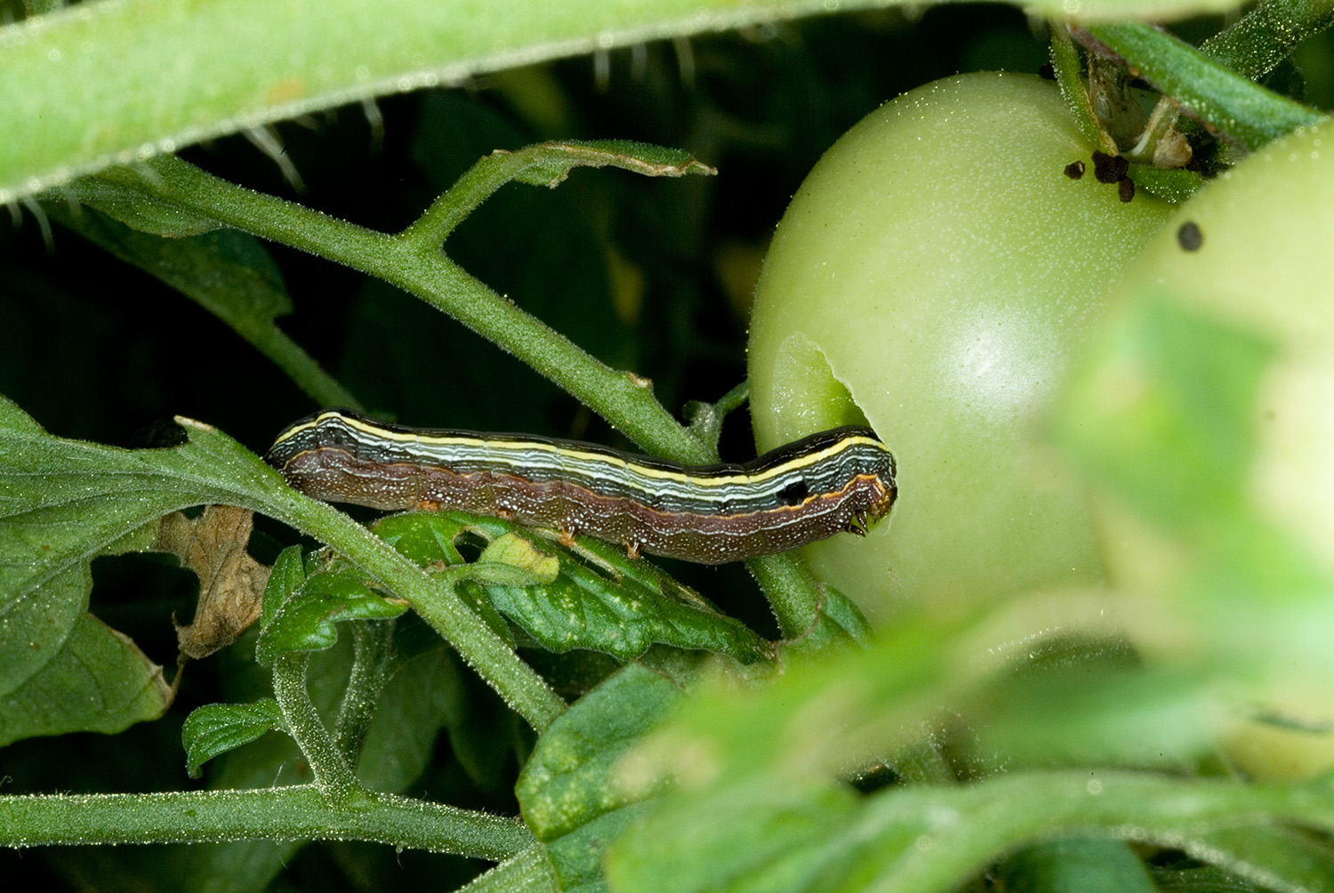
INTRODUCTION
Growing crops in open field has several
disadvantages like pests attacks,
extreme high/low temperature,
affect from radiations, wind, hailstorm.
In order to overcome these problems, Greenhouse were developed.
Attack of Yellow striped armyworm (Caterpillars) and Black frass pellets (near the top) to the tomato fruit.

Slide 5
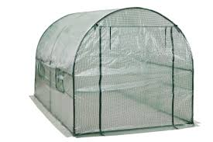
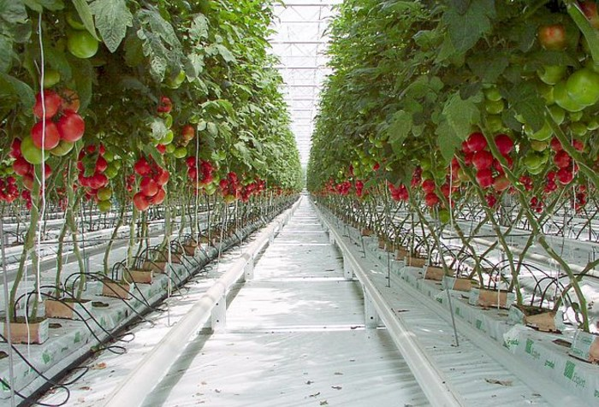
Greenhouse
Greenhouse are structures made of transparent materials where the user use to grow the plants with the required climatic conditions.
Fig: A simple greenhouse
ADVANTAGES
The yield can be 10-12 times more
off-season production
Protected from insects and diseases from them
Less requirement of water
In-house parameters can be controlled
Fig: Inside tomato greenhouse

Slide 6
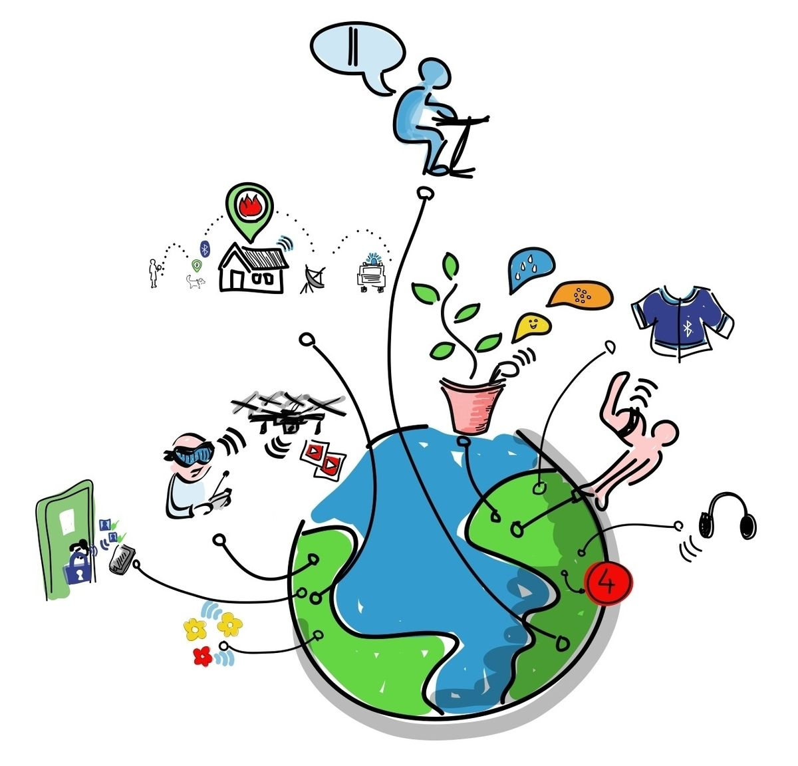
Internet of Things
Internet of Things is a technology which gives platform to inter-related computing devices, sensory devices, etc., to produce and exchange the data via the Internet.
There are many streams of IoT where the data is being generated daily. Home, Industrial, Automotive, Agriculture, Military, Medical and Healthcare, Environmental, Retail, etc.
These data are only limited to a specific domain or unused later for further purpose.

Slide 7
Data Abstraction
Data abstraction is the process of reducing multiple data to simplified version without altering the meaning.
There are many method like
Signal Preprocessing in which Low pass filter & High pass filter cuts the current signal with the cut-off frequency.
Mathematical/Statistical Preprocessing in which based on mean median, peaks of the data are removed. Min and Max cutoff.

Slide 8

Why do we need?
“Duplicate and dirty data costs the healthcare industry over $300 billion every year” – Joe Fusaro (Marketing Data analyst)
“Inaccurate data has a direct impact. The average company losing 12% of its revenue” – Ben Davis (Econsultancy)
The data generation will be high in future.
Processing of Such huge data takes time.
Majority of the data are unused later.
The semantic data Occupies less memory.
Can be used for further processing or further analytics.

Slide 9
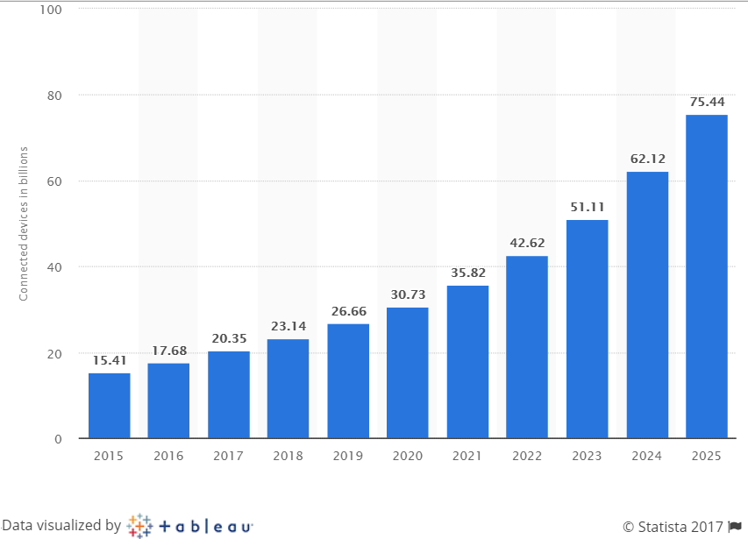
According to Gartner forecast, by 2020 nearly 21 billion devices will be connected to internet.
Fig : This statistic shows the number of connected devices (Internet of Things; IoT) worldwide from 2015 to 2025. (Source: Gartner )

Slide 10
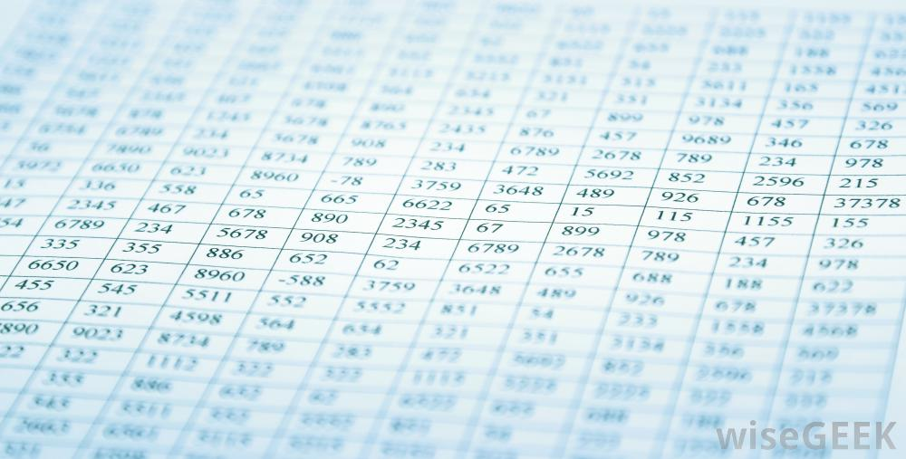
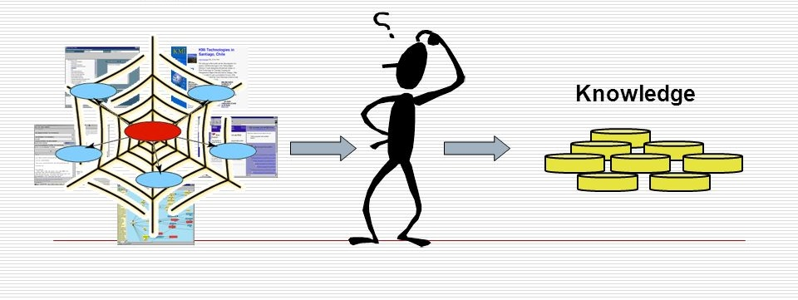
What we do
A huge amount of greenhouse data are produced.
Interesting information has to be extracted from the Raw data and correlation among the parameters has to be known.

Slide 11
Literature Survey
Authors | Title | Technology used | Output
Frieder Ganz, Daniel Puschmann, Payam Barnaghi (2015) | A Practical Evaluation of Information Processing and Abstraction Techniques for the Internet of Things | Information Abstraction Processes(Pre-processing, Dimensional Reduction, Feature Extraction) | Transformation of raw sensor data to human readable format
Daniel Puschmann et. Al (2016) | Adaptive Clustering for Dynamic IoT Data Streams | Adaptive clustering method(turning point) | Semantic data
Frieder Ganz (2013) | Information Abstraction for Heterogeneous Real World Internet Data | Symbolic Aggregate Approximation | Transmit of abstract data to the end device

Slide 12
Literature Survey(Cont..)
Authors | Title | Technology used | Output
Adnan Akbar, Francois Carrez, and Klaus Moessner et. al. (2015) | Context-Aware Stream Processing for Distributed IoT Applications | Micro Complex Event Processing and Adaptive Clustering | Extract high-level knowledge from data
Altti Ilari Maarala et al(2014) | Semantic data provisioning and Resoning for the Internet of Things | Aggregating and Reasoning engine | Delivering semantic data from IoT nodes
Daniel Puschmann, Payam Barnaghi et al. (2018) | Using LDA to Uncover the Underlying Structures and Relations in Smart City Data Streams | Piecewise aggregate approximation Symbolic Aggregate Approximation Latent Dirichlet Allocation | Correlation among traffic and temperature data

Slide 13
Literature Survey(Cont..)
Authors | Title | Technology used | Output
Daniel Puschmann, Payam Barnaghi et al. (2018) | Using LDA to Uncover the Underlying Structures and Relations in Smart City Data Streams | Piecewise aggregate approximation Symbolic Aggregate Approximation Latent Dirichlet Allocation | Correlation among traffic and temperature data
D M Blei et al. (2013) | Latent Dirichlet Allocation | Latent Dirichlet Allocation | Short representations of the discrete data

Slide 14
Greenhouse Sensors
Sensors sense the change in the environment of greenhouse and sends the information to other electronic devices like computer.
There are 2 types
Analog (0-1024)
Digital
Here, In order to work with the real time data, Virtual sensor programs are written which acts like the greenhouse Sensors based on the sensors used in monitoring greenhouse parameters.

Slide 15
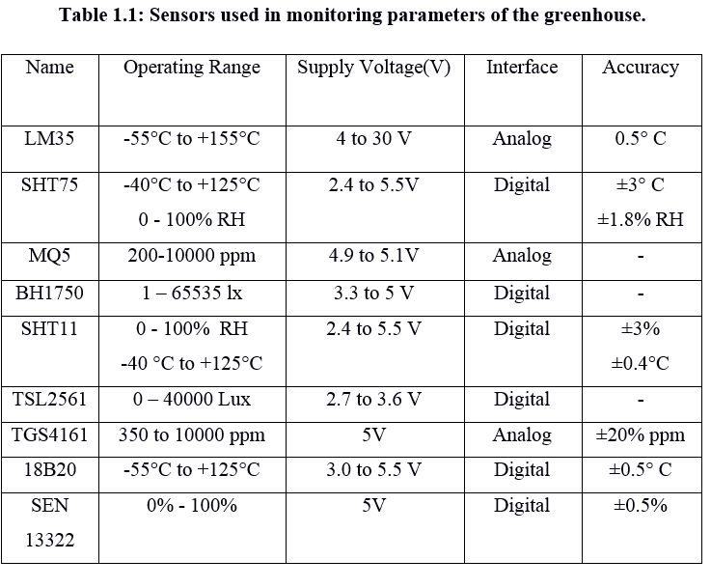
Sensors considered for Virtual sensor programs

Slide 16

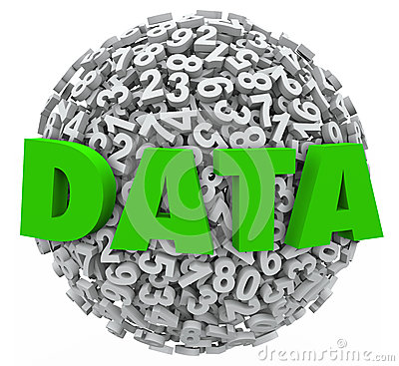

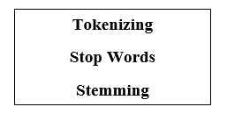
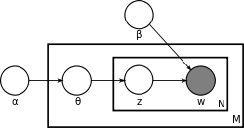
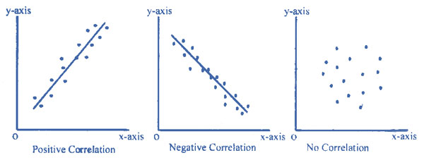
Ra
Data
Raw data
Abstraction
Data Preprocessing
Correlation
LDA

Slide 17
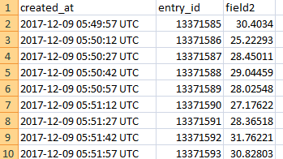
Raw Data
Raw data, also known as primary data, is data collected from a source. It is the data that has not been processed for use.
Created Virtual Sensor Program for different sensors and stored in different files.
Fig : Raw data
It consists of the values ranging from 0 to 1023 if the sensor is analog.
The digital sensor directly gives the unit output.
The data consists of randomness.

Slide 18
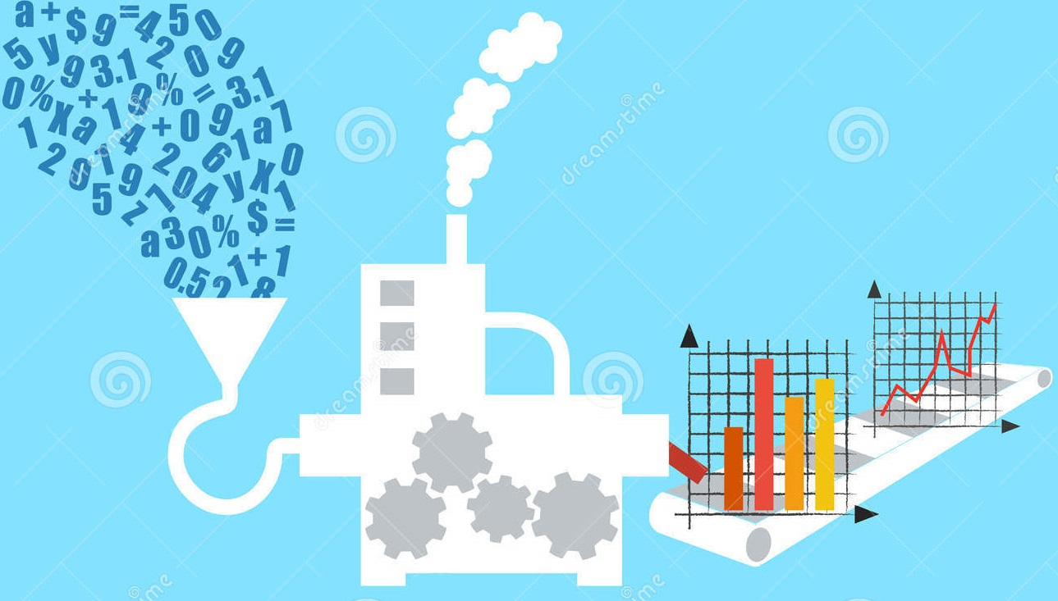
Data Abstraction
Data abstraction is the reduction of a particular body of data to a simplified representation of the whole. To gain more information about the data and infer knowledge.
Taking data input within a certain frequency.
Transformation of numerical or alphabetical digital information into a corrected, ordered, and simplified form.

Slide 19
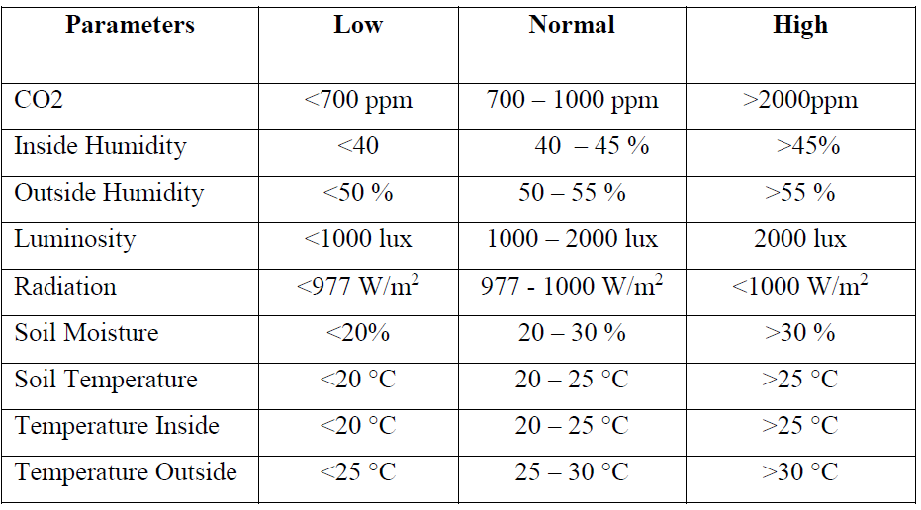
Fig: Conditions considered for abstraction

Slide 20
Preprocessing
Tokenizer: Tokenization is the act of breaking down the set of strings into pieces. It may contain words, symbols, phrases, keywords, etc. The abstracted data is given as the input to this model. It breaks the strings to form words.
eg: ‘soil moisture is normal’ -> ‘soil’ ‘moisture’ ‘is’ ‘normal’

Slide 21
Stop Words:
Stop words are words such as “the”, “a”, “is”, “an”, “in” etc., and the words that appear twice which can removed without altering the contents meaning.
eg: “ 'soil_moisture_is_normal', 'radiation_is_normal', 'soil_moisture_is_normal‘.”
-> 'soil_moisture_is_normal', 'radiation_is_normal',
Stemming:
Stemming is the process of removing the words which carry same meaning.
eg: outliers -> outlier
-> following -> follow

Slide 22
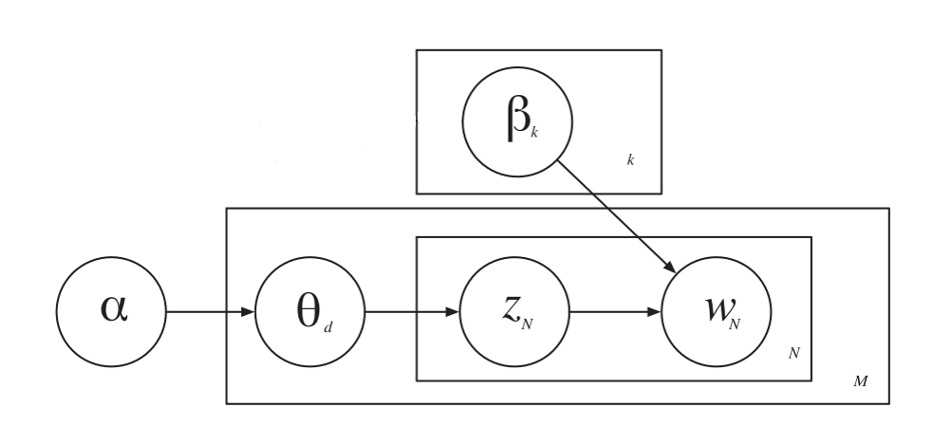
Latent Dirichlet Allocation
M is the total document set
N is the collection of the words represented by vector W_{N}
w is the particular word in the document
z_{ij} is the topic that is most likely to have generated w_{ij}.
k represents the number of topics which is fixed at the initial
θ is topic distribution
α is per document topic distribution
β is the multinomial distribution of words which represents the topics
j is the word count and i is document count.
Fig: Plate model Representation of LDA

Slide 23
Latent Dirichlet Allocation
LDA assumes documents are produced from a mixture of topics. Those topics then generate words based on their probability distribution.
Determine the number of words in a document. For example, let us assume the document has 6 words.
Determine the mixture of topics in that document. For example, the document might contain 1/2 the topic “health” and 1/2 the topic “vegetables.”
Using each topic’s multinomial distribution, output words to fill the document’s word slots. In our example, the “health” topic is 1/2 our document, or 3 words. The “health” topic might have the word “diet” at 20% probability or “exercise” at 15%, so it will fill the document word slots based on those probabilities.

Slide 24
Software Requirements:
Ubuntu Operating System
Python3
Libraries
Numpy
Nltk and Nltk.tokenize
Stop words
Nltk.stem.porter
Gensim
Hardware Requirements:
RAM 2GB or Higher
Storage 100GB or Higher
Intel i5 with 4CPU cores and operating frequency of CPU at 2.60GHz is used.

Slide 25
Results
Greenhouse parameters temperature, humidity, co2 concentration, luminosity, radiation, soil moisture and soil temperature are considered.
Virtual sensor programs are written to get the real-time data.
The data are stored in the files with respect to the sensor.
The raw sensor values are converted to respective parameter unit according to the sensor conversion formula and checked with the respective conditions provided.

Slide 26
Then the text file is read by the LDA module which calculates the probability of occurrences of every phrases. The correlation among the parameters of the greenhouse is found by it.
LDA reads 10 text files at a time in which each individual text file contains 10 samples of abstracted data. The LDA algorithm was tuned to produce 1 topics on each run with various data sets.
In the first test, all the parameters are kept to normal and checked with the probability.

Slide 27
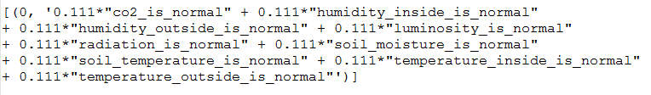
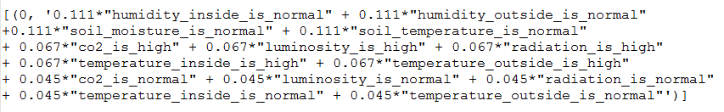
Fig: LDA results when all the parameters are kept normal
In second test, the parameters like inside temperature, outside temperature, luminosity, radiation and co2 of some files are changed from normal to high. The result obtained are shown in figure.
Inside temperature is high when the outside temperature is high which has got the same probability and are related. Radiation and luminosity has got the same probability and are related to each other.
Fig: LDA results with variable parameters1

Slide 28
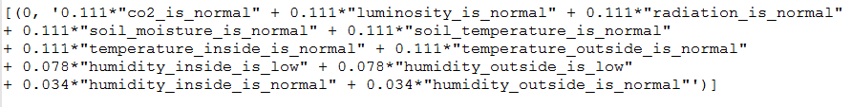
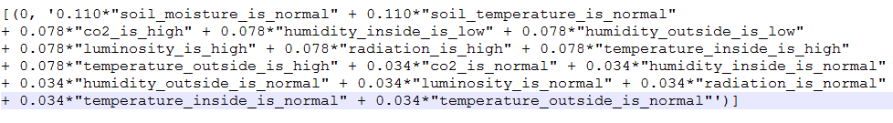
In the third test, inside humidity and outside humidity are changed from normal to low in some of the files and obtained same probability which is shown in figure.
Fig: LDA results with variable parameters2
In the fourth test, inside temperature, outside temperature, co2, luminosity and radiation are changed from normal to high. Inside humidity and outside humidity are changed from normal to low and noted that the parameters like inside temperature, co2, radiation and luminosity changes when the outside temperature is changed. Inside humidity is affected by the outside humidity.
Fig: LDA results with variable parameters3

Slide 29
The following correlations were found out.
Outside temperature is high is highly correlated with inside temperature being high. This is also related to both inside and outside humidity as high and other factors like radiation and CO2 both being high.
Humidity inside being low is related to humidity outside being low, normal luminosity and normal soil moisture and CO2 being normal.
Also, temperature is normal, co2 and humidity normal is related to all other attributes being normal.

Slide 30
Conclusion
In this work, a novel approach to extract the Information hidden in the raw IoT data from Greenhouse and to find the correlation among the data.
The process involves collecting the raw data from the sensory devices in a particular frequency and representing the equivalent text form for respective sensors data. The semantic form of the data is further preprocessed with the techniques tokenization, removal of stop words and stemming.
Further the abstracted data is given to LDA, a topic modelling method to find the correlation among different parameters of the Greenhouse. Hence, LDA can be used to find the correlation among the greenhouse parameters

Slide 31
References
[1] Frieder Ganz, Student Member, IEEE, Payam Barnaghi, Senior Member, IEEE, and Francois Carrez. “Information Abstraction for Heterogeneous Real World Internet Data,” IEEE SENSORS JOURNAL, VOL. 13, NO. 10, OCTOBER 2013.
[2] A. Akbar, F. Carrez, K. Moessner, J. Sancho, and J. Rico, “Context-aware stream processing for distributed IoT applications,” in Internet of Things (WF-IoT), 2015 IEEE 2nd World Forum on, 2015, pp. 663–668.
[3] E. Masciari, “A framework for outlier mining in RFID data,” in Proc. International Database Engineering and Applications Symposium, 2007, pp. 263–267.
[4] Frieder Ganz, Daniel Puschmann, Payam Barnaghi, “A Practical Evaluation of Information Processing and Abstraction Techniques for the Internet of Things”, 10.1109/JIOT.2015.2411227, IEEE Internet of Things Journal.

Slide 32
References
[6] Frieder Ganz, Daniel Puschmann, Payam Barnaghi, “A Practical Evaluation of Information Processing and Abstraction Techniques for the Internet of Things”, 2327-4662 (c) 2015 IEEE.
[7] Sefki Kolozali , Daniel Puschmann, Athanasios Karapntelakis Et al. “Real‐Time IoT Stream Processing and Large‐scale Data Analytics for Smart City Applications”, GRANT AGREEMENT No 609035 FP7‐SMARTCITIES‐2013
[8] Daniel Puschmann, Payam Barnaghi, “Adaptive Clustering for Dynamic IoT Data Streams”, 2327-4662 (c) 2016 IEEE.
[9]Altti Ilari Maarala et al.Semantic Data Provisioning and Reasoning for the Internet of Things

Slide 33
PO Mapping / Reflections
Research skills: Based on the literature survey done, various advantages of block chain technology were known. Along with this defects of older technology for solving the problem mentioned were known.
Usage of modern tools: For execution of this project, tools like solidity and mint browser are used.
Problem solving and critical thinking: To identify the pain point and map it to the technology used to arrive at the desired solution.

Slide 34
THANK YOU

